Slide 1
New Frontiers of Knowledge Graph Reasoning: Recent Advances and Future Trends
Part IV. Neural Reasoning Beyond Entities and Relations (2)
Jiaxin Bai
Department of CSE, HKUST
Notes:
Welcome to the tutorial on "New Frontiers of Knowledge Graph Reasoning: Recent Advances and Future Trends." In this part, we'll be discussing neural reasoning beyond entities and relations, part two.

Slide 2

Roadmap
Part I: Knowledge Graph Reasoning: Basic Concepts and Techniques
Part II: Recent Advance #1: Neural Reasoning for Natural Language Queries
Part III: Recent Advance #2: Neural Reasoning for Logical Queries
Part IV: Recent Advance #3: Neural Reasoning Beyond Entities and Relations
Part V: Recent Advance #4: LLM+KGR
Part VI: Open Challenges and Future Directions
Notes:
Here is out general road map.

Slide 3
The Three-dimensional Development of Knowledge Graphs in Computer Science
The deveopment of the Web
1. Knowledge Graph Reasoning over Entities and Numerical Values [paper][code]
Web 3.0
Generations of KGs
2. Complex Query Answering on Eventuality Knowledge Graph with Implicit Logical Constraints [paper][code]
G#3: Dual Neural KGs
Web 2.0
G#2: Text-Rich KGs
3. Complex Reasoning over Logical Queries on Commonsense Knowledge Graphs [paper]
G#1: Entity-Based KGs
Web 1.0
Semantic Units
Entities/Concepts/Properties
Events/Processes
Intents/Beliefs/Desires
3
Notes:
In the previous section, we looked at the cutting-edge developments in knowledge graphs across three different dimensions, and introduced two of the dimensions, development of the web and generations of KGs.
Now, in this section, we're going to dive into three specific neural knowledge graph reasoning works that correspond to the third dimension. And these works deal with varied semantic units.
The first work we'll look at is called "Knowledge Graph Reasoning over Entities and Numerical Values." This one talks about reasoning at the entity, property, and attribute level.
The second work is "Complex Query Answering on Eventuality Knowledge Graphs with Implicit Logical Constraints." Here, we're dealing with reasoning at the event and process level.
And finally, the third work is "Complex Reasoning over Logical Queries on Commonsense Knowledge Graphs." This one tackles commonsense reasoning over beliefs, intentions, and desires.
So, by covering these three levels of semantic units, we'll get a well-rounded understanding of knowledge graph reasoning techniques and how they can be applied in different semantic units.

Slide 4
Numerical Complex Query Answering
Category
Complex Queries
Interpretations
Numerical CQA
Find the Turing award winners
that
is born before
the year of
1927.
Numerical CQA
Find the states in US that have
a
higher latitudes
than Beijing.
Numerical CQA
Find the states in US that have a
twice smaller population
than
California?
Notes:
In the first work, Knowledge Graph Reasoning over Entities and Numerical Values, we focus on answering the complex logical queries involving numerical values.
For example, Find the Turing award winners that is born before 1927, finding the states in US that have higher latitudes than Beijing and find the status in US that have a twice smaller population than California.
As introduced in previous parts, various query encoding methods employ different structures for encoding queries and use distinct parameterizations for their logic and projection operations. However, they cannot deal with numbers.

Slide 5
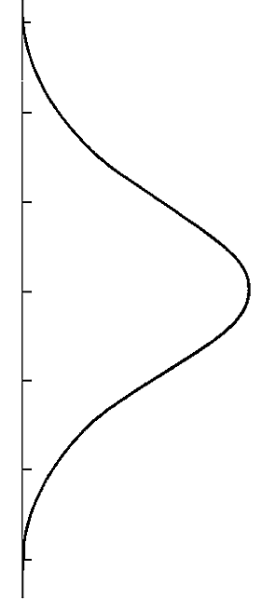










Number Reasoning Network
Find the cities that have a higher latitudes than Japanese cities.
q$=V_{?} . ∃{V_{1}, X}_{1},X_{2}:\underline{\text{HasLatitude}}\left(V_{?},X_{2}\right) ∧\underline{GreaterThan}\left(X_{2},X_{1}\right)∧\underline{HasLatitude}\left(V_{1},X_{1}\right)∧ LocatedIn\left(V_{1}, Japan\right)$
$$HasCity$$
$$HasLatitude$$
$$GreaterThan$$
$HasLatitide$⁻¹
$$Japan$$
$$Target$$
50°
50°
$$Tokyo$$
40°
40°
$$Kyoto$$
30°
30°
$$Japan$$
20°
20°
$$Osaka$$
(1) Relational
Projection
(2) Attribute
Projection
(3) Numerical
Projection
(4) Reverse
Attribute Projection
Jiaxin Bai, Chen Luo, Zheng Li, Qingyu Yin, Bing Yin, Yangqiu Song: Knowledge Graph Reasoning over Entities and Numerical Values. KDD 2023: 57-68
Notes:
To address the limitations of them, we propose the number reasoning network (NRN) method.
Take this query Find the cities that have a higher latitudes than Japanese cities as an example.
Suppose we want to answer the logic query, which asks to find cities with higher latitude than Japanese cities. The query is first parsed into a computational graph and then encoded using the NRN method, which uses separate encoding phases for entities and numerical values.

Slide 6



Number Reasoning Network
Relational Projection (rp):
Query Embedding → Entity Set
(2) Attribute Projection (ap):
Query Embedding → Value Distribution
(3) Numerical Projection (np):
Value Distribution → Value Distribution
(4) Reverse Attribute Projection (rap):
Value Distribution → Query Embedding
50°
50°
$$Tokyo$$
40°
40°
$$Kyoto$$
30°
30°
$$Osaka$$
20°
20°
(1) Relational
Projection
(2) Attribute
Projection
(3) Numerical
Projection
(4) Reverse
Attribute Projection
Notes:
We go through this example step-by-step.
First, the entity embedding of the anchor entity "Japan" is obtained, and a relational projection is used to compute the representation of "cities in Japan" as part of the entity phase.
Then, the numerical value distribution indicating the "latitude values of cities in Japan" are computed using an attribute projection.
The NRN method then compute the distribution of latitude values that are greater than the previous results, using a numerical projection of "GreaterThan."
The resulting distribution is then used in a reverse attribute projection to find cities with latitude values that satisfy the query's conditions, and the encoding process switches back to the entity phase.

Slide 7
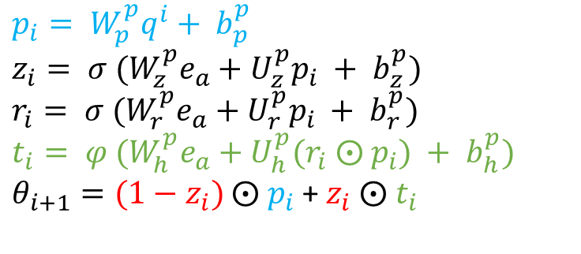
Number Reasoning Network
(1) Relational Projection:
Adopted from the backbones:
GQE, Query2Box, Query2Particles.
(2) (3) (4) Other Projections: Gated Transitions
Linear projection
$$p_{i}= W_{p}^{p}q^{i}+ b_{p}^{p}$$
$$z_{i}= {{σ (W}_{z}^{p}e}_{a}+U_{z}^{p}p_{i} + b_{z}^{p})$$
$$r_{i}= {{σ (W}_{r}^{p}e}_{a}+U_{r}^{p}p_{i} + b_{r}^{p})$$
$$t_{i}= {{φ (W}_{h}^{p}e}_{a}+U_{h}^{p}{(r}_{i} ⨀ p_{i}) + b_{h}^{p})$$
$θ_{i+1}=(1−z_{i})$ $⨀$ $p_{i}$ + $z_{i} ⨀$ $t_{i}$
MLP
Gate selection
50°
50°
$$Tokyo$$
40°
40°
$$Kyoto$$
30°
30°
$$Osaka$$
20°
20°
(1) Relational
Projection
(2) Attribute
Projection
(3) Numerical
Projection
(4) Reverse
Attribute Projection
Notes:
To handle logical operations for entities such as intersection and union, we utilize established query encoding methods as the backbones in the number reasoning network. Specifically, we also use the three different encoding structures - GQE, Q2B, and Q2P - in the implementation.
For the other projection operators, we use gated transition to parameterize. Which involcs a linear projection, MLP and Gate selection

Slide 8
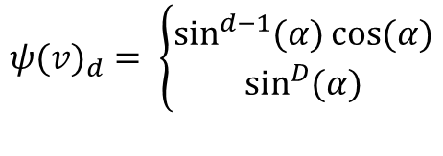
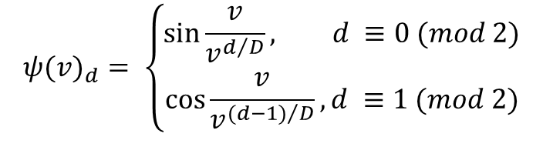
Number Reasoning Network
Entity embeddings:
Adopted from the backbones:
GQE, Query2Box, Query2Particles.
Input number embeddings
DICE
Sinusoidal
$${ψ(v)}_{d}= \left\{\begin{aligned}\sin{\frac{v}{v^{d/D}},} d ≡0 (mod 2) \\ \cos{\frac{v}{v^{{(d−1)}/D}}}, d ≡1 (mod 2)\end{aligned}\right.$$
$${ψ(v)}_{d}= \left\{\begin{aligned}\sin^{d−1}{(α)\cos{(α)}} \\ \sin^{D}{(α)}\end{aligned}\right.$$
50°
50°
$$Tokyo$$
40°
40°
$$Kyoto$$
30°
30°
$$Osaka$$
20°
20°
(1) Relational
Projection
(2) Attribute
Projection
(3) Numerical
Projection
(4) Reverse
Attribute Projection
Dhanasekar Sundararaman, Shijing Si, Vivek Subramanian, Guoyin Wang, Devamanyu Hazarika, and Lawrence Carin. 2020. Methods for Numeracy-Preserving Word Embeddings. In EMNLP. 4742–4753
Ashish Vaswani, Noam Shazeer, Niki Parmar, Jakob Uszkoreit, Llion Jones, Aidan N. Gomez, Lukasz Kaiser, and Illia Polosukhin. 2017. Attention is All you Need. NeurIPS 2017
Notes:
To compute NRN query embeddings, we need to use numerical embeddings to project the attribute values from R to RD to obtain numerical embeddings for NRN. We use two deterministic numerical encodings - DICE and Sinusoidal encoding of value.
DICE is a deterministic independent-of-corpus word embedding of numbers. The Sinusoidal encoding of value was first proposed for encoding token position in the transformer model, but we have found it to be effective in encoding numerical values as well. This function works well in our setting, and its input values do not necessarily have to be integers.

Slide 9
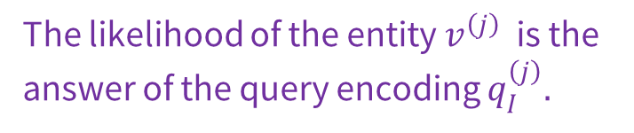
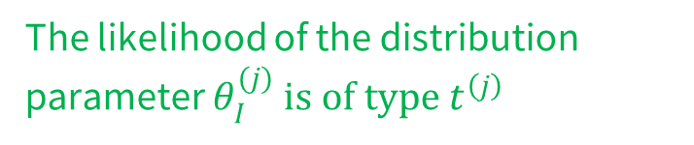
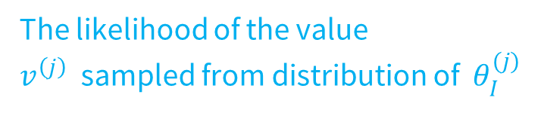
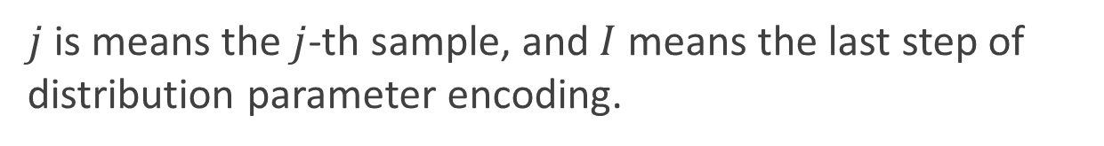
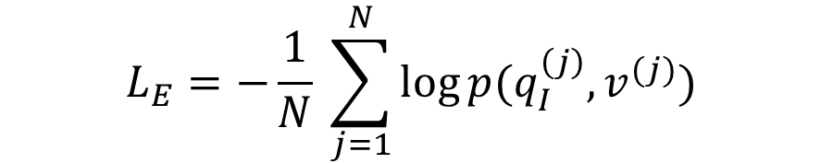
Number Embeddings and Learning Objective
End-to-end training by Joint optimization of two losses:
$L_{A}= \frac{1}{M}\sum_{j=1}^{M}{(− \log{p_{θ_{I}^{(j)}} \left( ψ\left(v^{\left(j\right)}\right)\right) − \log{φ_{t^{\left(j\right)}}(θ_{I}^{(j)})}})}$
The likelihood of the value $v^{\left(j\right)}$ sampled from distribution of $θ_{I}^{(j)}$
The likelihood of the distribution parameter $θ_{I}^{(j)} is of type{ t}^{\left(j\right)}$
$$L_{E}=−\frac{1}{N} \sum_{j=1}^{N}{\log{p(q_{I}^{\left(j\right)}, v^{(j)})}}$$
The likelihood of the entity $v^{\left(j\right)}$ is the answer of the query encoding $q_{I}^{\left(j\right)}.$
$j$ is means the $j$-th sample, and $I$means the last step of distribution parameter encoding.
Notes:
During the learning process, we use joint optimization of two losses.
The first loss is over the numerical distribution, where we use the first term to describe the probability of v in the distribution of Θ, and the second term describes the probability of distribution Θ being of type T.
The second loss is for minimizing the distribution differences of the predicted entities and answer entities over the entity space. By jointly optimizing these two losses, we can effectively train the NRN model to handle complex queries involving both entities and numerical values.

Slide 10
The Three-dimensional Development of Knowledge Graphs in Computer Science
The deveopment of the Web
1. Knowledge Graph Reasoning over Entities and Numerical Values [paper][code]
Web 3.0
Generations of KGs
2. Complex Query Answering on Eventuality Knowledge Graph with Implicit Logical Constraints [paper][code]
G#3: Dual Neural KGs
Web 2.0
G#2: Text-Rich KGs
G#1: Entity-Based KGs
Web 1.0
Semantic Units
Entities/Concepts/Properties
Events/Processes
Intents/Beliefs/Desires
10
Notes:
In the second work, we introduce Complex Query Answering on Eventuality Knowledge Graph with Implicit Logical Constraints. This work discuss how to conduct logical reasoning over knowledge graphs describing event and processes.

Slide 11

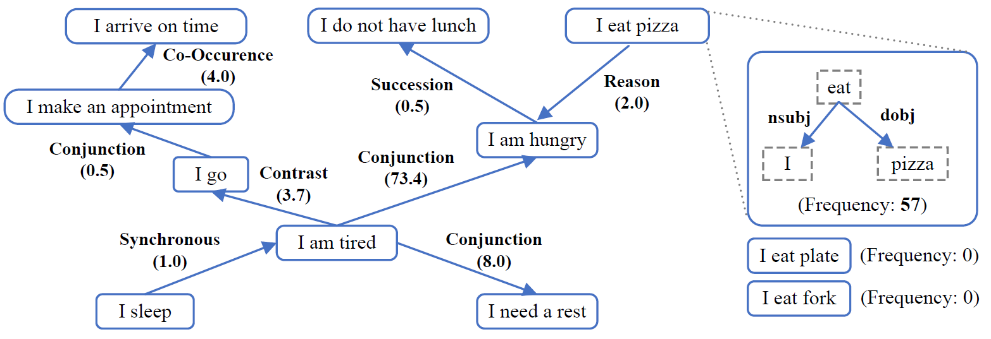
ASER (Activities, States, Events, and their Relations)
Principle 1: Comparing semantic meanings by fixing grammar (Katz and Fodor, 1963)
Principle 2: The need of language inference based on ‘partial information’ (Wilks, 1975)
https://github.com/HKUST-KnowComp/ASER
Hongming Zhang, Xin Liu, Haojie Pan, Yangqiu Song, Cane Wing-Ki Leung: ASER: A Large-scale Eventuality Knowledge Graph. WWW 2020: 201-211
Katz, J. J., & Fodor, J. A. (1963). The structure of a semantic theory. Language, 39(2), 170–210.
Yorick Wilks. 1975. An intelligent analyzer and understander of English. Communications of the ACM, 18(5):264–274.
Notes:
In the work of eventuality reasoning, we use ASER as our KG dataset.
The ASER KG is constructed for describing the relations between activities, states, and events. It is built by the syntactic and semantic parsers following the principle of Comparing semantic meanings by fixing grammar and The need of language inference based on ‘partial information’ .

Slide 12
CQA on Eventuality Knowledge Graph
Complex query on eventuality graphs are different from the entity-relation graph
Whether and when the eventualities occur are important
Queries
Type
Interpretations
Entity
Find the substances that interact with the
proteins associated with Alzheimer’s and
Mad cow disease.
Eventuality
Food
is bad before
PersonX
add soy sauce.
What is the reason for food being bad?
Eventuality
Instead
of buying an umbrella,
PersonX
go
home.
What happened before
PersonX
go
home?
Jiaxin Bai, Xin Liu, Weiqi Wang, Chen Luo, Yangqiu Song: Complex Query Answering on Eventuality Knowledge Graph with Implicit Logical Constraints. NeurIPS, 2023
Notes:
Complex query on eventuality graphs are different from the entity-relation graph
This is because whether and when the eventualities occur are important in the reasoning processes.
For example, in an event-centric KG, suppose we know food is bad before person add soy sauce, if we ask the question what is the reason for food being bad, then adding soy sauce cannot be the reason. Because something happens later cannot be the reason of something happens before.
For another example, suppose we know instead of buying an umbrella, personX go home, then we if we ask what happened before person go home, then buying an umbrella should not be an answer because it does not happened.

Slide 13
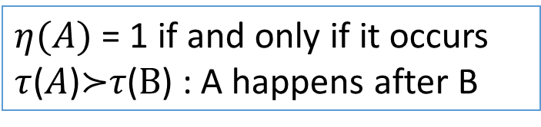
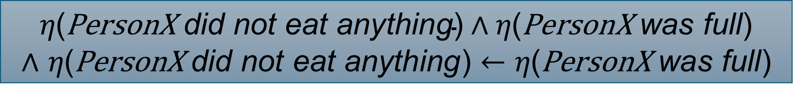
Discourse Relations and Implicit Constraints
PersonX did not eat anything because PersonX was full
Reason($\text{PersonX}$ did not eat anything, $\text{PersonX}$ was full)
Occurrence Constraint
$η\text{(}\text{PersonX} \text{did} \text{not} \text{eat} \text{anything}\text{)}∧η\text{(}\text{PersonX} \text{was} \text{full}\text{)}$
∧ 𝜂($\text{PersonX} \text{did} \text{not} \text{eat} \text{anything}$) $←\text{η}\text{(}\text{PersonX} \text{was} \text{full}$)
Temporal Constraints
$τ$($\text{PersonX}$ did not eat anything) $≻τ$($\text{PersonX}$ was full)
$η(A)$ = 1 if and only if it occurs
$τ$($A$)$≻$𝜏($B$) : A happens after B
Notes:
How can we describe the such constraints over the occurrence of events and temporal order of events?
Use logical expressions derived from discourse relations!
We use \ita to denote whether an event happens, and \tau to denote the temporal order of event.
Then we can derive the following expressions. $\text{PersonX} \text{did} \text{not} \text{eat} \text{anything}$ and $\text{PersonX} \text{was} \text{full}$ both happens and $\text{PersonX} \text{was} \text{full}$ causes $\text{PersonX} \text{did} \text{not} \text{eat} \text{anything}$. Meanwhile, we know $\text{PersonX}$ did not eat anything happens after $\text{PersonX} \text{was} \text{full}$.

Slide 14
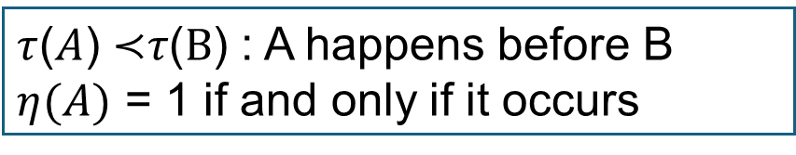
Discourse Relations and Implicit Constraints
Food is bad before PersonX add soy sauce
Precedence(Food is bad, PersonX adds soy sauce)
Occurrence Constraint
$$η\text{(}\text{Food} \text{is} \text{bad}\text{) }∧η\text{(}\text{PersonX} \text{adds} \text{soy} \text{sauce}\text{)}$$
Temporal Constraints
$τ$(Food is bad) $≺τ$(PersonX adds soy sauce)
$τ$($A$) $≺$𝜏($B$) : A happens before B
$η(A)$ = 1 if and only if it occurs
Notes:
Here is an example of temporal relations, which means “Food is bad ” and “PersonX add soy sauce” both happens and Food is bad before PersonX add soy sauce

Slide 15
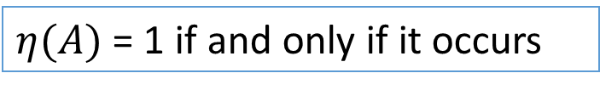
Discourse Relations and Implicit Constraints
Instead of buying an umbrella, PersonX go home
$\text{ChosenAlternative}$(buying an umbrella, $\text{PersonX}$ go home)
Occurrence Constraint
$$η\left(\text{PersonX} \text{go} \text{home}\right)∧¬ η\left(\text{PersonX} \text{buy} \text{an} \text{umbrella}\right)$$
$η(A)$ = 1 if and only if it occurs
Notes:
Here is a example of occurrence constraints, which means $\text{PersonX}$ go home happens and buying an umbrella does not happens.

Slide 16
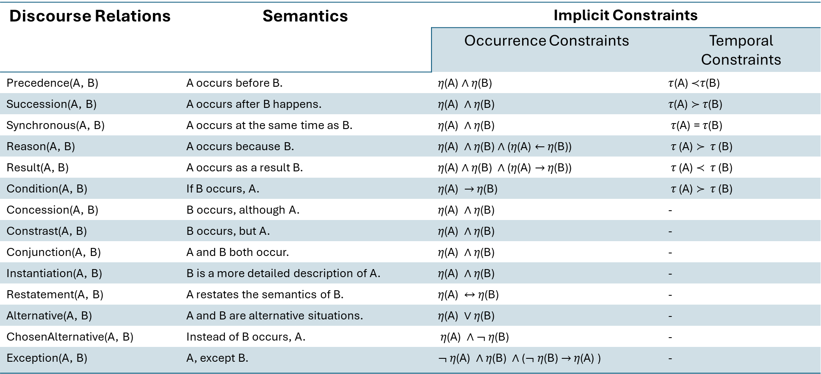
Logical Constraints behind Discourse Relations
Discourse Relations | Semantics | Implicit Constraints
 |  | Occurrence Constraints | Temporal Constraints
Precedence(A, B) | A occurs before B. | 𝜂(A) ∧ 𝜂(B) | $τ$(A) $≺$𝜏(B)
Succession(A, B) | A occurs after B happens. | 𝜂(A) ∧ 𝜂(B) | 𝜏(A) $≻$ 𝜏(B)
Synchronous(A, B) | A occurs at the same time as B. | 𝜂(A) ∧ 𝜂(B) | 𝜏(A) = 𝜏(B)
Reason(A, B) | A occurs because B. | 𝜂(A) ∧ 𝜂(B) ∧ (𝜂(A) $←$ 𝜂(B)) | 𝜏 (A) $≻$ 𝜏 (B)
Result(A, B) | A occurs as a result B. | 𝜂(A) ∧ 𝜂(B) ∧ (𝜂(A) $→$ 𝜂(B)) | 𝜏 (A) $≺$ 𝜏 (B)
Condition(A, B) | If B occurs, A. | 𝜂(A) $→$ 𝜂(B) | 𝜏 (A) $≻$ 𝜏 (B)
Concession(A, B) | B occurs, although A. | 𝜂(A) ∧ 𝜂(B) | -
Constrast(A, B) | B occurs, but A. | 𝜂(A) ∧ 𝜂(B) | -
Conjunction(A, B) | A and B both occur. | 𝜂(A) ∧ 𝜂(B) | -
Instantiation(A, B) | B is a more detailed description of A. | 𝜂(A) ∧ 𝜂(B) | -
Restatement(A, B) | A restates the semantics of B. | 𝜂(A) $↔$ 𝜂(B) | -
Alternative(A, B) | A and B are alternative situations. | 𝜂(A) $∨$ 𝜂(B) | -
ChosenAlternative(A, B) | Instead of B occurs, A. | 𝜂(A) ∧ $¬$ 𝜂(B) | -
Exception(A, B) | A, except B. | $¬$ 𝜂(A) ∧ 𝜂(B) ∧ ($¬$ 𝜂(B) $→$ 𝜂(A) ) | -
$τ$($A$) $≺$𝜏($B$) : A happens before B, $η(A)$ = 1 if and only if it occurs
Notes:
Here is the table of logical constraints behind the discourse relations. Both occurrence constraints and temporal constraints can be derived by the discourse relations. For example A before B, A as a result B, If A then B, A or B, A and B. A except B.

Slide 17
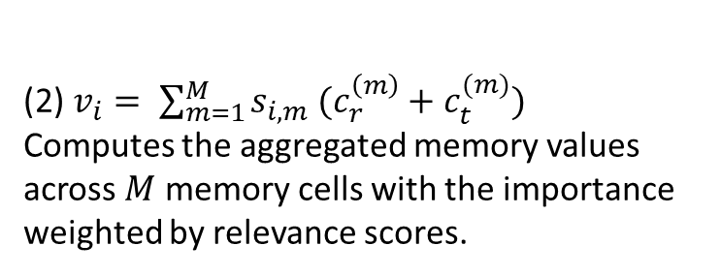
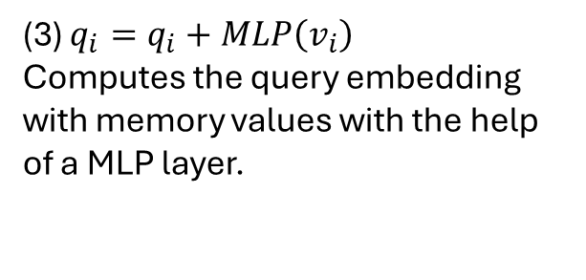
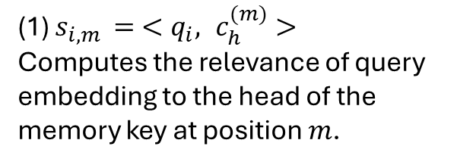
Query Encoding with Constraint Memory
Computational Graph
(3)
Constraint Memory
V?
Key
Value
(2)
Reason
Food is bad
Precedence
PersonY
adds soy sauce
Intersection
(1)
PersonY
adds ketchup
PersonY
adds vinegar
ChosenAlter.
Succession
Succession
PersonX
complains
PersonX leaves
restaurant
…
…
…
(1) $s_{i,m }= <q_{i}, c_{h}^{(m)}>$
Computes the relevance of query embedding to the head of the memory key at position $m$.
(2) $v_{i}= \sum_{m=1}^{M}{s_{i,m} (c_{r}^{\left(m\right)}+c_{t}^{(m)})}$
Computes the aggregated memory values across $M$ memory cells with the importance weighted by relevance scores.
(3) $q_{i}=q_{i}+MLP\left(v_{i}\right)$
Computes the query embedding with memory values with the help of a MLP layer.
Jiaxin Bai, Xin Liu, Weiqi Wang, Chen Luo, Yangqiu Song: Complex Query Answering on Eventuality Knowledge Graph with Implicit Logical Constraints. NeurIPS, 2023
Notes:
To address the logical constraints within the process of answering complex logical queries, we propose the query encoding method with constraint memory. For each encoding process of computation graph of a complex query, we first Computes the relevance of query embedding to the head of the memory key at position $m, then$Computes the aggregated memory values across $M$ memory cells with the importance weighted by relevance scores. And finally, we add back the constraints values from the constraint memory with memory values with the help of a MLP layer.

Slide 18
The Three-dimensional Development of Knowledge Graphs in Computer Science
The deveopment of the Web
1. Knowledge Graph Reasoning over Entities and Numerical Values [paper][code]
Web 3.0
Generations of KGs
2. Complex Query Answering on Eventuality Knowledge Graph with Implicit Logical Constraints [paper][code]
G#3: Dual Neural KGs
Web 2.0
G#2: Text-Rich KGs
3. Complex Reasoning over Logical Queries on Commonsense Knowledge Graphs [paper]
G#1: Entity-Based KGs
Web 1.0
Semantic Units
Entities/Concepts/Properties
Events/Processes
Intents/Beliefs/Desires
18
Notes:
the third work is "Complex Reasoning over Logical Queries on Commonsense Knowledge Graphs." This one tackles commonsense reasoning over beliefs, intentions, and desires with a emphasis on commonsense knowledge KG.

Slide 19
Moving towards intention based commonsense complex question answering
Reasoning on real-world text and narratives requires complex reasoning over multiple events, and inferring implicit context.
drink a glass of ice cold water
cause
X moves to a new place
Air pollution
cause
Lung Cancer
cause
effect
Smoking
X makes new friends
Getting coronary artery disease
cause
It was a hot and sunny day, but John feels much better!
Diabetes
X throws a party
Obesity
…
Abduction
Common cause
multi-hop effects
Tianqing Fang, Zeming Chen, Yangqiu Song, Antoine Bosselut. Complex Reasoning over Logical Queries on Commonsense Knowledge Graphs. Arxiv 2024.
Notes:
Specifically, We targets on intention based commonsense complex question answering.
Reasoning on real-world text and narratives requires complex reasoning over multiple events, and inferring implicit context.
For abduction, here are some examples: It was a hot and sunny day, but John feels much better! This is very likely because he drink a glass of ice water. And this process is a type of abductive reasoning.
For common cause, smoking is a common cause of lung cancer and getting Getting coronary artery disease.
Moving to a new places causes making new friend and further causes throwing a party, and this is multi-hop effects.

Slide 20


Complex Commonsense Reasoning
Sampling conjunctive logical queries over existing CSKG
$q\left[V_{?}\right]=V_{?}:$xIntent$\left(X goes sky diving , V_{?}\right)$
$$∧\text{xWant} (X gets tired of it, V_{?})$$
(the intention of PersonX)
xIntent
PersonX goes skydiving
Sampling synthetic query at scale
Perform verbalization to make the query in natural language
Define reasoning (question) based on the relations.
find new things to do
PersonX gets tired of it
xWant
(then PersonX wants to)
Verbalization
🤖️
LLM-added
context
PersonX is living a boring life.
Base CSKG: ATOMIC2020
Rule-based
discourse
After getting tired of it
PersonX goes skydiving
Question:
What’s both the intention of PersonX going skydiving
and what X wants to do after PersonX getting tired of it?
Answer:
find new things to do
Tianqing Fang, Zeming Chen, Yangqiu Song, Antoine Bosselut. Complex Reasoning over Logical Queries on Commonsense Knowledge Graphs. Arxiv 2024.
Notes:
To systematically measure different MLP models to conduct complex commonsense reasoning, we propose a method of generating such complex commonsense questions from CSKGs.
We sample conjunctive logical queries and their answers from commonsense KG, then we use LLM to verbalize the queries and answers as natural language questions answering pairs.

Slide 21
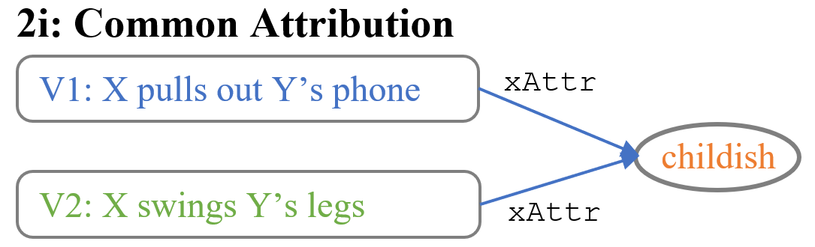
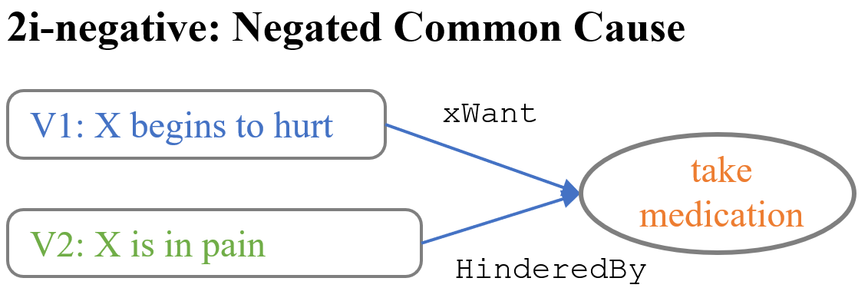
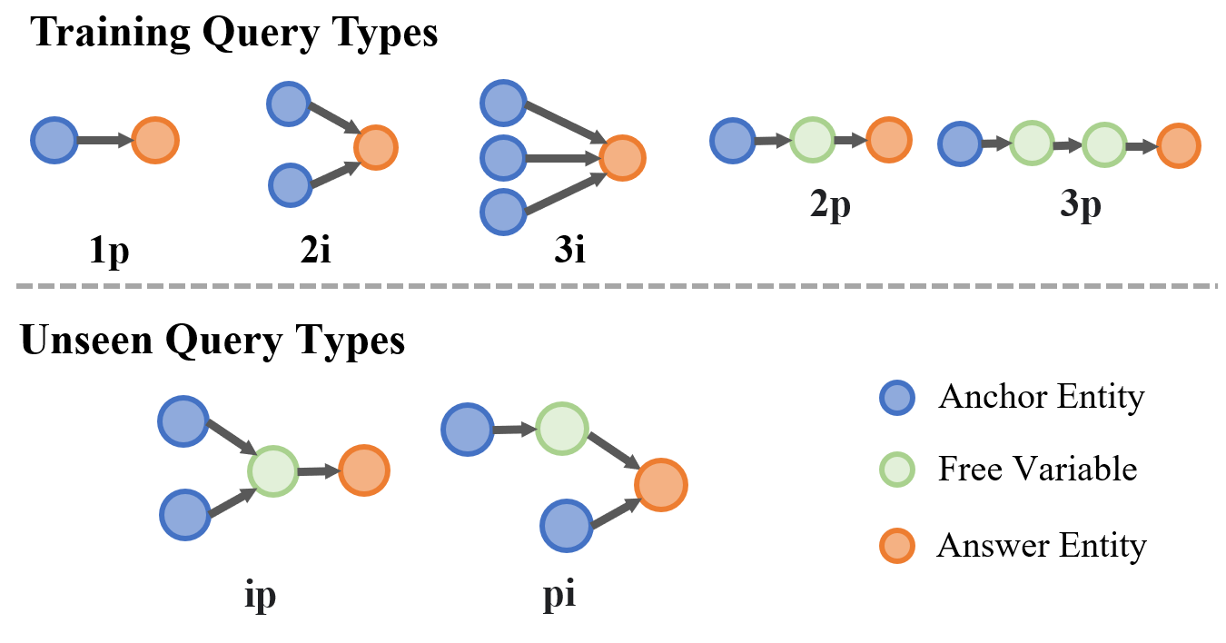
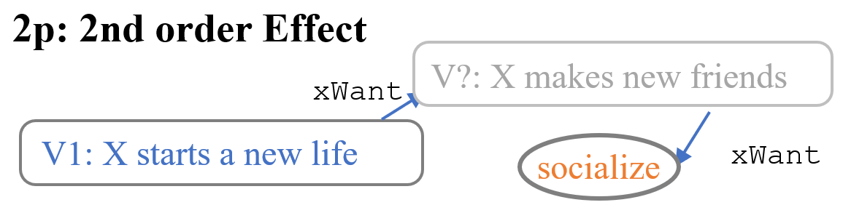
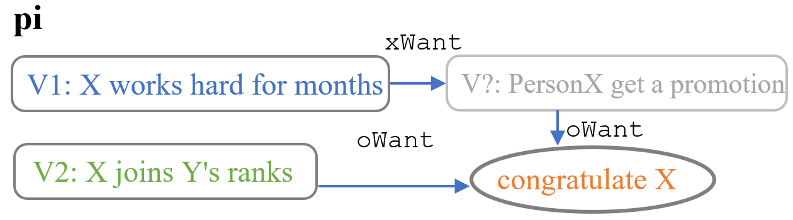
Conjunctive Logical Queries
Similar to CQA problems
Tianqing Fang, Zeming Chen, Yangqiu Song, Antoine Bosselut. Complex Reasoning over Logical Queries on Commonsense Knowledge Graphs. Arxiv 2024.
Notes:
Similar to CQA problems, we sample 5 types of training queries, and hold out 2 types of queries for out of distribution evaluation types.
Here are some examples like commonse attribution, negated commosen sense, second order effects, and multi-hop conjunctive query.

Slide 22
Benchmarking
Multiple-Choice QA:
Negative sampling: 2 are randomly sampled across CSKB, 2 are randomly sampled across one-hop answers (hard negative).
An additional “No answers are correct option”
Generative complex commonsense reasoning
53 annotators
Fleiss Kappa: 0.445; IAA: 78%
All disagreements are fixed by experts
#Train | 790k
#Eval (annotated) | 1,317
%wrong verbalization | 4.5%
%sampled answers that are plausible | 52.1%
%sampled negatives that are plausible | 23.5%
Tianqing Fang, Zeming Chen, Yangqiu Song, Antoine Bosselut. Complex Reasoning over Logical Queries on Commonsense Knowledge Graphs. Arxiv 2024.
Notes:
After using LLM to verbalize the logical queries on commonsense KGs, we use the generated question answering pairs to further construct a mutple-choice QA benchmark. For negative samples, 2 are randomly sampled across CSKB, 2 are randomly sampled across one-hop answers (hard negative). Meanwhile we provide No answers are correct option.
We hire 53 annotators to annotate, their fleiss kappa is 0.445 and IAA of 78%. All disagreements are fixed by experts.

Slide 23
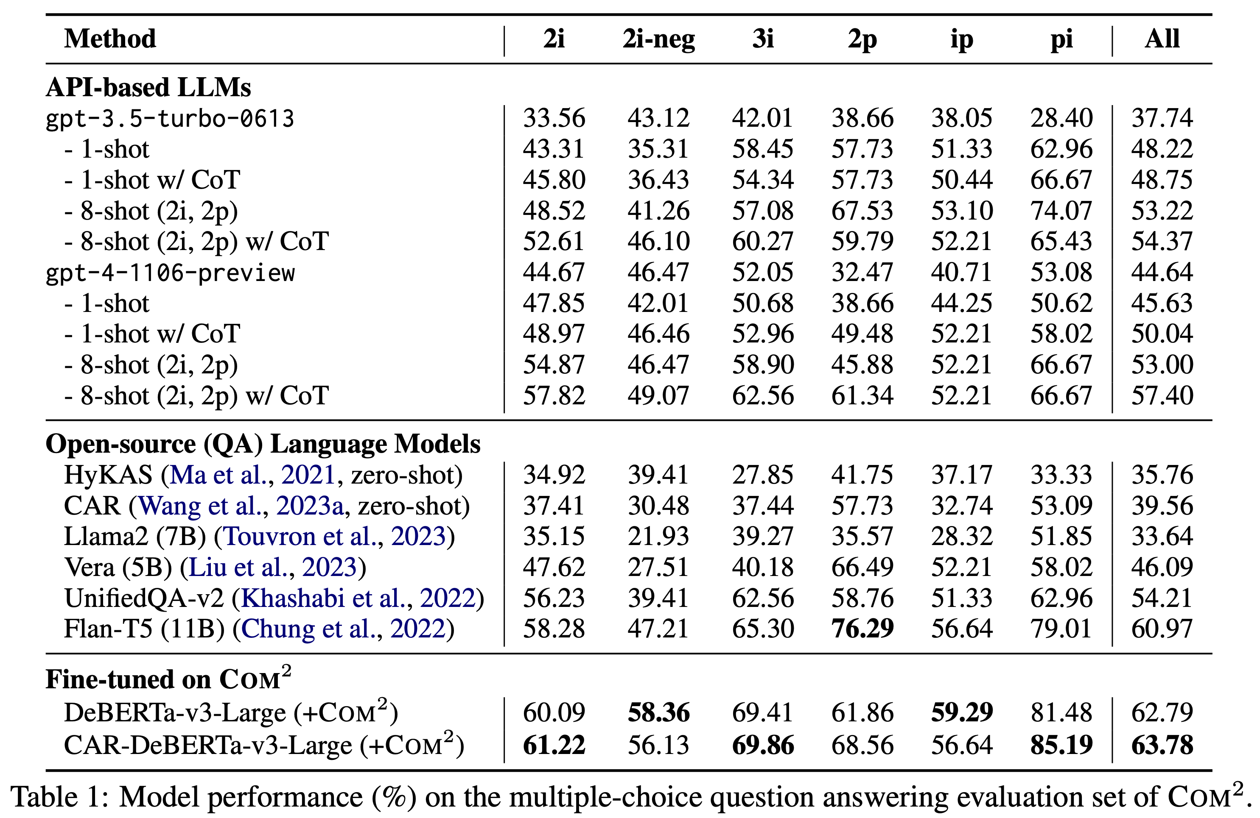
LLMs Still Fall Short on This Task
GPT: 37.74%~57.40%
Open LLMs: 33.64%~60.97%
Finetuned: 62.79%~63.78%
Tianqing Fang, Zeming Chen, Yangqiu Song, Antoine Bosselut. Complex Reasoning over Logical Queries on Commonsense Knowledge Graphs. Arxiv 2024.
Notes:
Here is the performance of the complex commonsense dataset. GPT is able to achieve 37%~57%, open LLM achieves 33%~60%. The fine-tuned pre-trained LMs can achieves 62~63 in this benchmark.

Slide 24
The Three-dimensional Development of Knowledge Graphs in Computer Science
The deveopment of the Web
1. Knowledge Graph Reasoning over Entities and Numerical Values [paper][code]
Web 3.0
Generations of KGs
2. Complex Query Answering on Eventuality Knowledge Graph with Implicit Logical Constraints [paper][code]
G#3: Dual Neural KGs
Web 2.0
G#2: Text-Rich KGs
3. Complex Reasoning over Logical Queries on Commonsense Knowledge Graphs [paper]
G#1: Entity-Based KGs
Web 1.0
Semantic Units
Entities/Concepts/Properties
Events/Processes
Intents/Beliefs/Desires
24
Notes:
Then we have covered all three types of semantic units on this horizontal axis with three different works in knowledge graph reasoning.

Slide 25
Conclusions for Part 4-2
We have reviewed the frontier of recent development of knowledge graphs in terms methods of different semantic units:
Entity/attributes
Events/processes
Intent/desire/belief
More recent advances in KG reasoning combined with LLMs will be introduced in Part 5 by Lihui Liu
Notes:
We have reviewed the frontier of recent development of knowledge graphs in terms methods of different semantic units:
Entity/attributes
Events/processes
Intent/desire/belief
More recent advances in KG reasoning combined with LLMs will be introduced in Part 5 by Lihui Liu
That is all of this part. Thank you!

